Slide 1


Session Title-Mode Session No.: 03 Course Name: Probability and statistics Course Code: C1UC322T Duration:50 Minutes

Slide 2
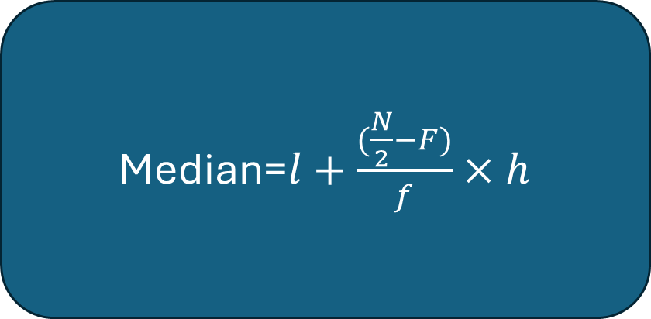
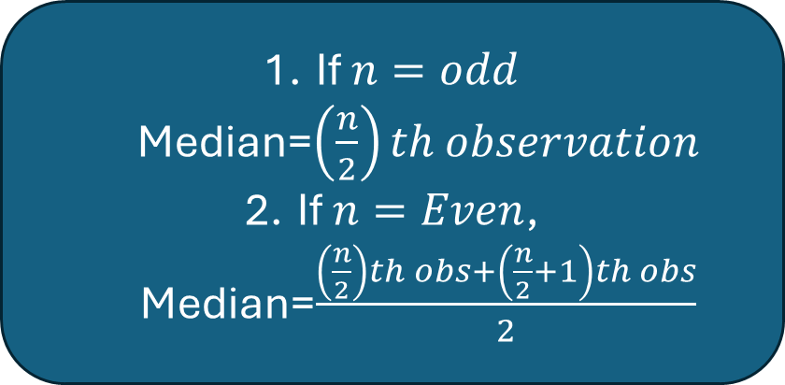
Review of the key concepts of session no. 3
Median
For Ungrouped Data
For Grouped Data
If $n=odd$ Median=$\left(\frac{n}{2}\right)th observation$
If $n=Even$, Median=$\frac{\left(\frac{n}{2}\right)th obs+\left(\frac{n}{2}+1\right)th obs}{2}$
Median=$l+\frac{(\frac{N}{2}−F)}{f}×h$

Slide 3
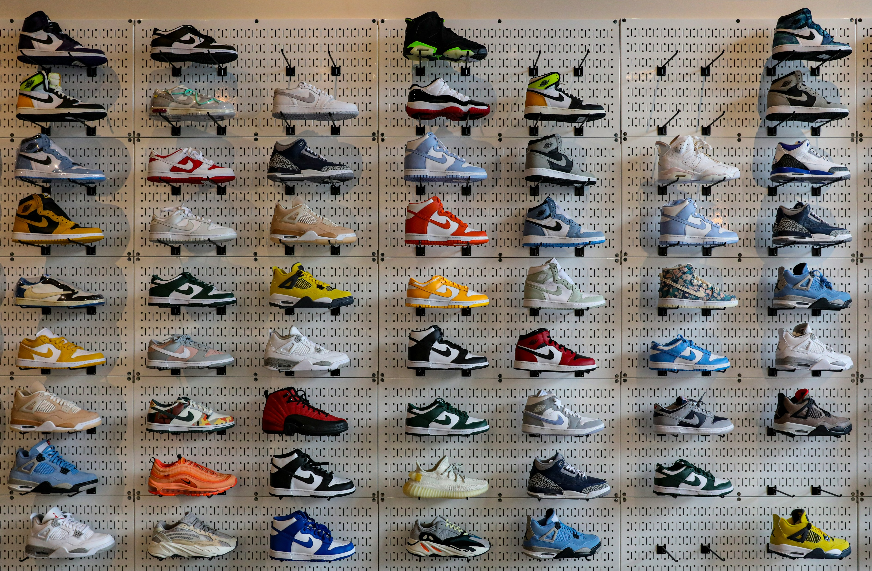
Write down the birth months of your class
Write down shoe numbers of your class

Slide 4
Ask Questions
Identify the most common shoe size and birth month of your class
Try to relate with topic.

Slide 5
At the end of this session students will be able to At the end of this lesson, students will be able to
Learning Outcomes
Identifying the most frequent observations in a dataset.
Compute the mode for ungrouped and grouped data.

Slide 6
Session Outline
1 Introduction of mode
2 Discussion on engaging questions
3 Mode of ungrouped data
4 Mode of grouped data
5 Wrap up and Reflection

Slide 7
Mode-The mode is that value of an observation which occurs most frequently in the data set, that is, the point (or class mark) with the highest frequency.
The concept of mode is of great use to large scale manufacturers of consumable items such as ready-made garments, shoe-makers, and so on. In all such cases it is important to know the size that fits most persons rather than ‘mean’ size. There are many practical situations in which arithmetic mean does not always provide an accurate characteristic (reflection) of the data due to the presence of extreme values.

Slide 8
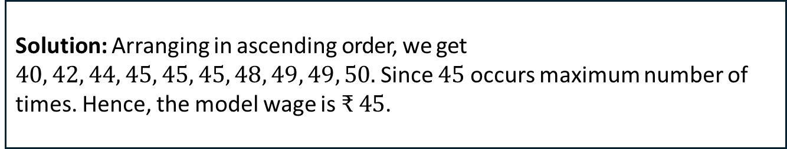
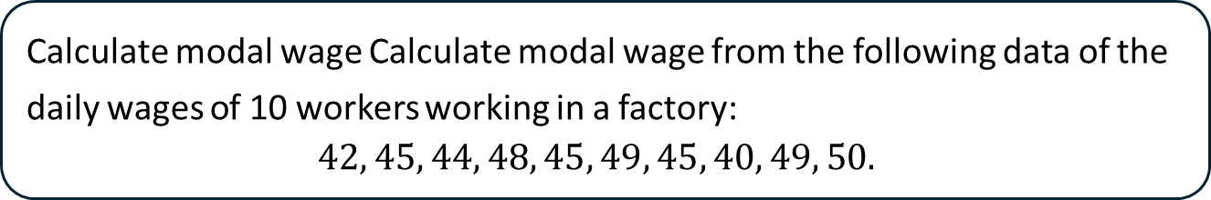
Calculate the mode in individual data:
Calculate modal wage Calculate modal wage from the following data of the daily wages of 10 workers working in a factory:
$$42, 45, 44, 48, 45, 49, 45, 40, 49, 50.$$
Solution: Arranging in ascending order, we get $40, 42, 44, 45, 45, 45, 48, 49, 49, 50.$Since $45$ occurs maximum number of times. Hence, the model wage is $₹ 45$.

Slide 9
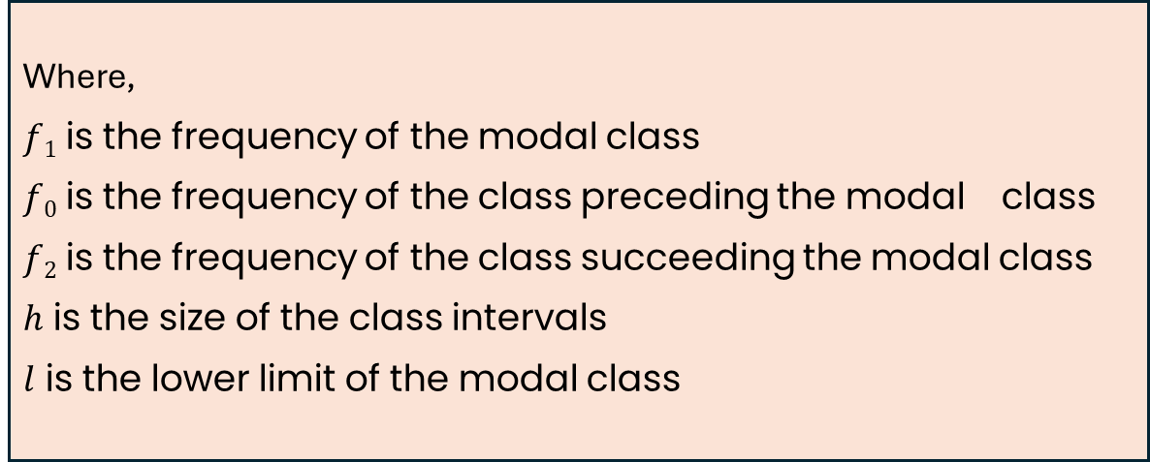
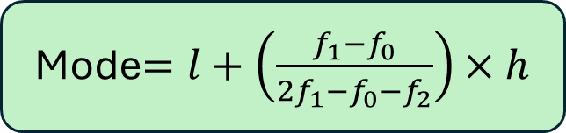
Mode for the grouped data
In the case of grouped data, it is not possible to identify the mode of the data, by looking at the frequency of data. In this scenario, we can determine the mode value by locating the class with the maximum frequency called modal class. Inside a modal class, we can locate the mode value of the data by using the formula,
Where,
$f1$ is the frequency of the modal class
$f0$ is the frequency of the class preceding the modal class
$f2$ is the frequency of the class succeeding the modal class
$h$ is the size of the class intervals
$l$ is the lower limit of the modal class
Mode$=l+\left(\frac{f_{1}−f_{0}}{{2f}_{1}−f_{0}−f_{2}}\right)×h$

Slide 10
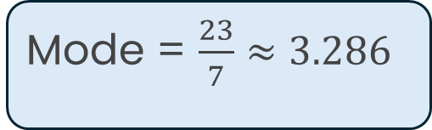
Que. A survey has been conducted by a group of students on 20 households in a locality as shown in the following frequency distribution table. Find the mode for the given data.
Size of family | 1-3 | 3-5 | 5-7 | 7-9 | 9-11
No. of families | 7 | 8 | 2 | 2 | 1
Mode = $\frac{23}{7}≈3.286$

Slide 11
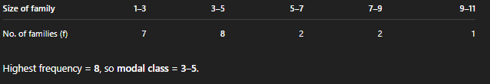
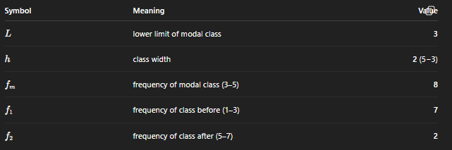
Solution

Slide 12
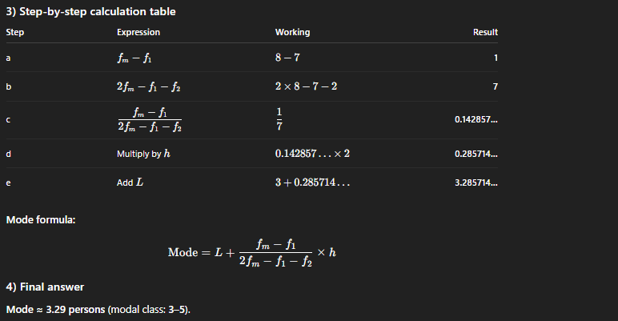

Slide 13
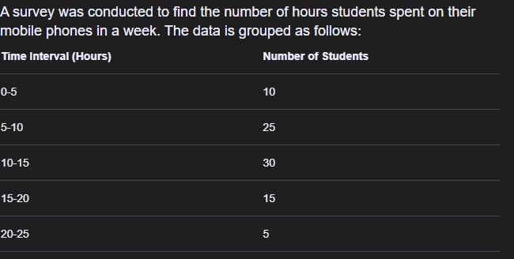
Learning Activity 1

Slide 14
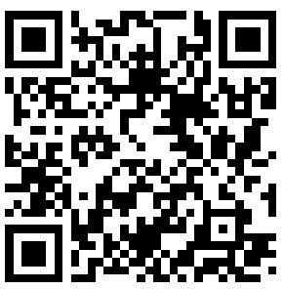

Learning Activity 1
Reflection

Slide 15
Summary
In this session we have discussed the concept of mode and some real-life situations where, mode is best suitable central tendency to represent data set.

Slide 16
Summary
Exit ticket
In what situations might the mode be misleading or not useful?

Slide 17
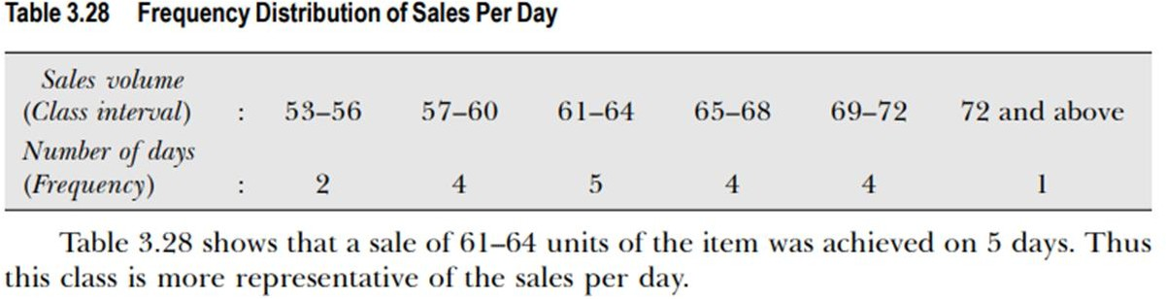
Discussion on the post session activities
Using the data of Table 3.28, calculate the mode of sales distribution of the units of item during the 20 days period.

Slide 18
In the next Lecture we will discuss the concept of Measure of Dispersion.

Slide 19
Thank You

